Slide 1
Linux Kernel
Modular structure
Collection of loadable modules: they implement OS functions and execute in kernel mode on behalf of current process
Dynamic linking
Stackable modules: hierarchy between clients and libraries
Notes:
1

Slide 2
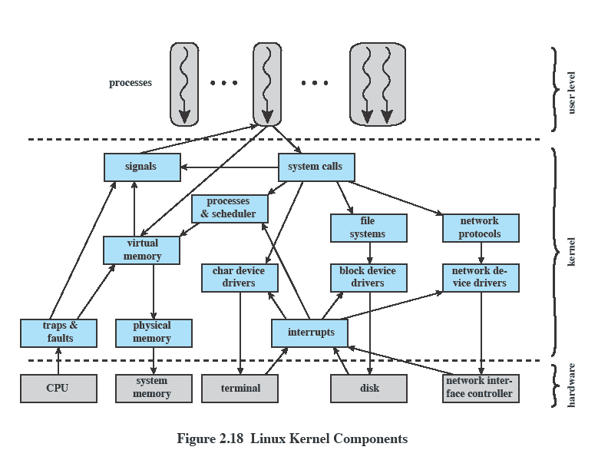
Linux Kernel Component
Notes:
2

Slide 3
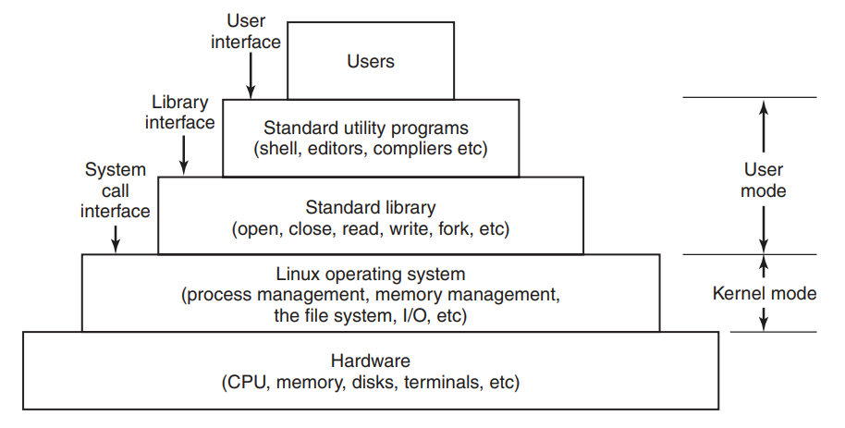
Linux Kernel Component

Slide 4
Linux Kernel Component
Signals:
System calls:
Processes and scheduler:
Virtual memory:
File systems:
Network protocols:
Character device drivers:
Block device drivers:
Network device drivers:
Traps and faults:
Physical memory:
Interrupts:

Slide 5
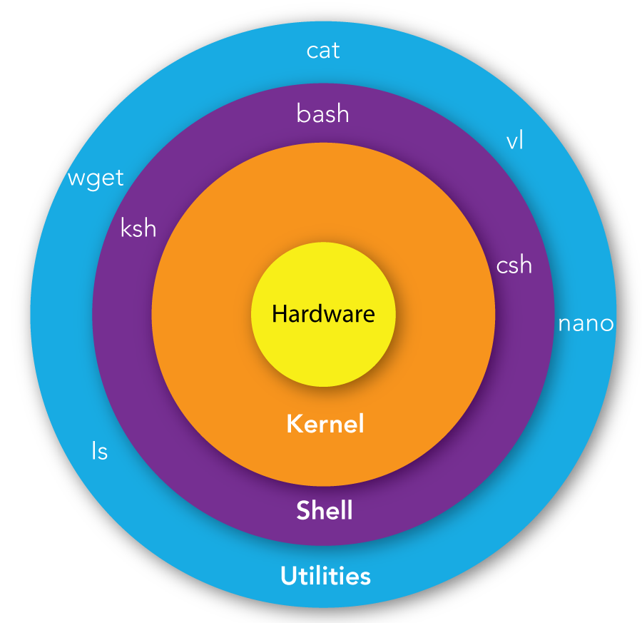
SHELL
A shell is special user program which provide an interface to user to use operating system services.

Slide 6
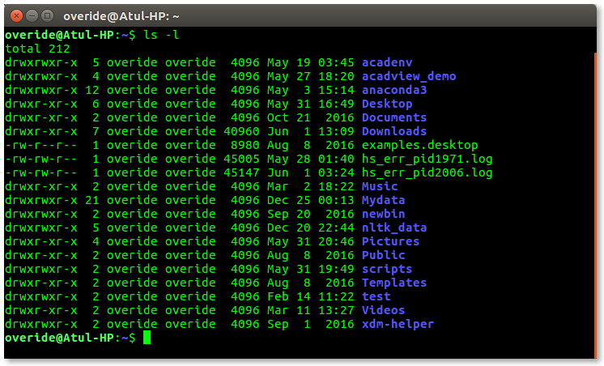
Command Line Shell

Slide 7
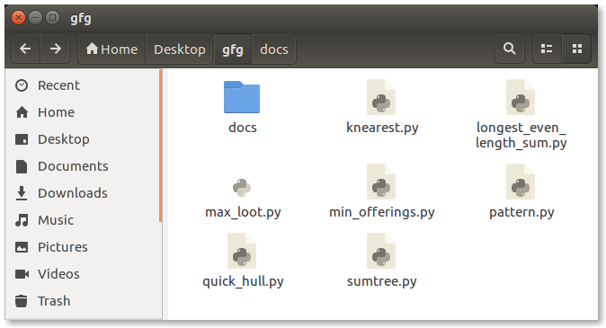
Graphics Shell

Slide 8
Shell Types
There are several shells are available for Linux systems like –
BASH (Bourne Again Shell)
CSH (C Shell)
KSH (Korn Shell)

